Slide 1
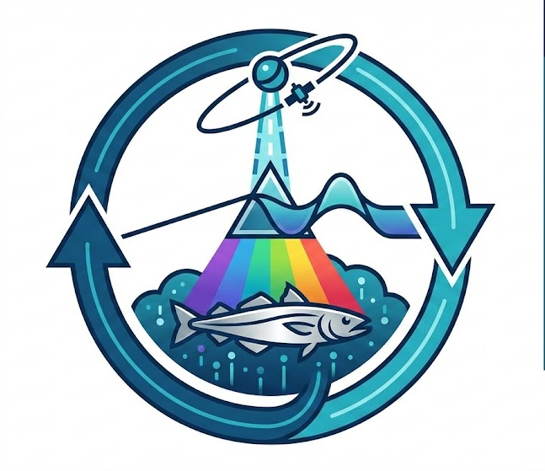
Trawling4PACE
Victoria Abunaw
Frederic Bonou
Leandro Machado Cruz
Mary Kate Munley
Punya Puthukulangara
Haley Synan
Justine Whitaker

Slide 2
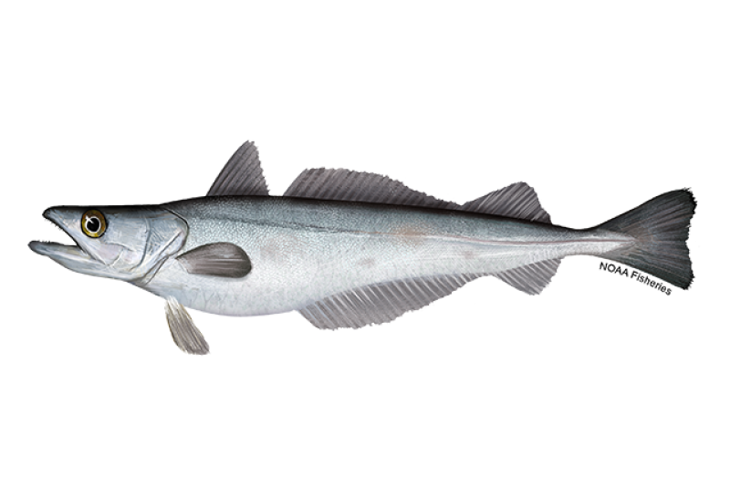
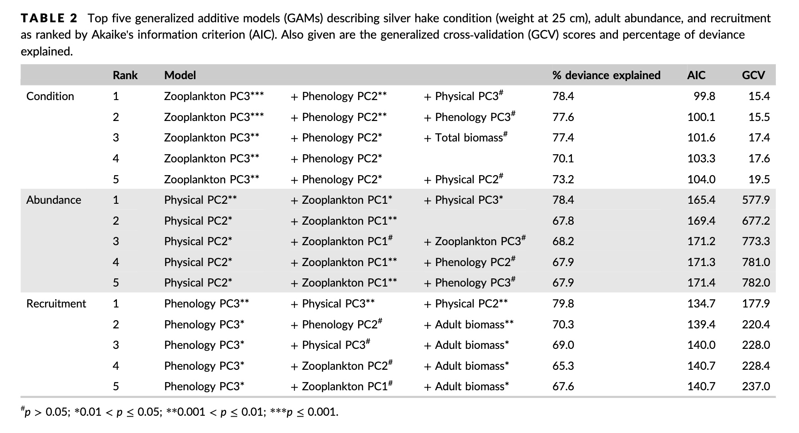
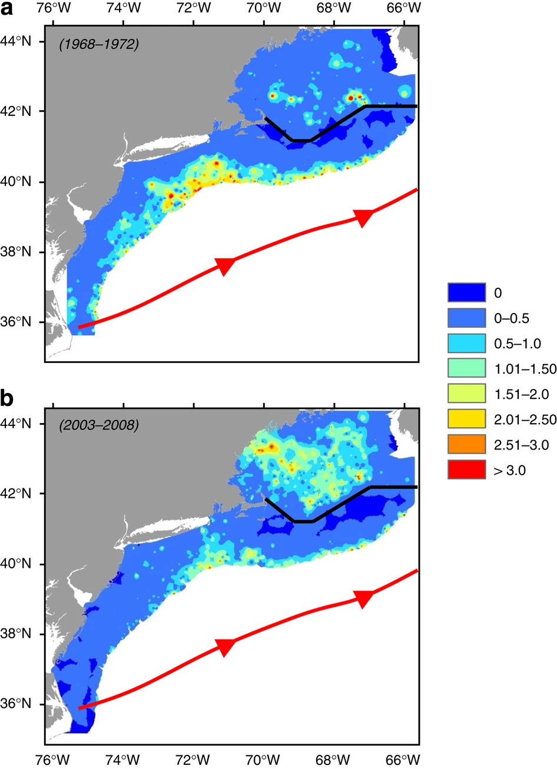
Reed et al. 2018
Silver Hake (Merluccius bilinearis)
Silver and Red Hake - whiting
Groundfish fishery
Distribution linked to Gulf Stream
Condition, Abundance and Recruitment linked to zooplankton, SST and plankton blooms
Nye et al. 2011
Notes:
MK

Slide 3
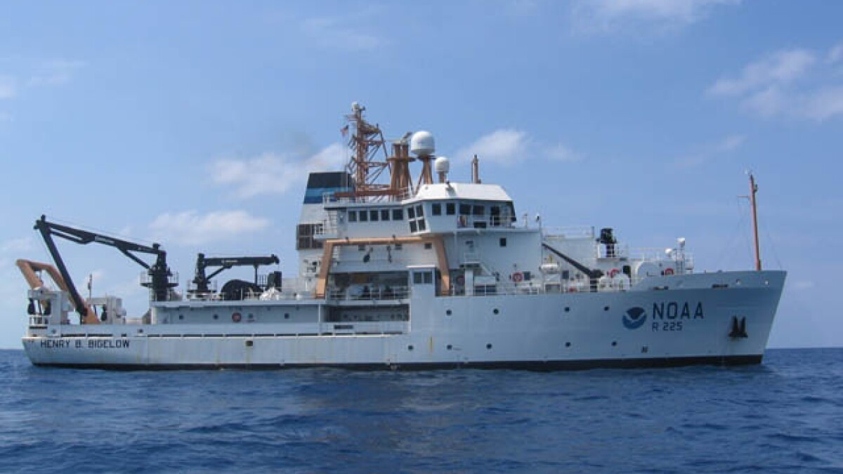
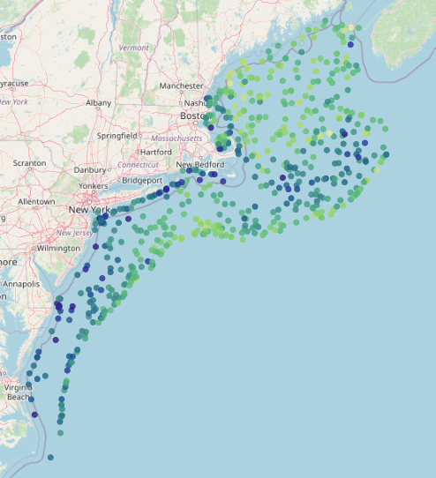
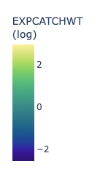
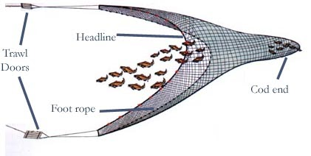
Datasets
NEFSC bottom trawls
Fall: Mar - May
Spring: Sep - Nov
Fall and Spring 2024
Spring 2025
Notes:
MK

Slide 4
Data
Remotely sensed data
Finite-Size Lyapunov Exponent (FSLE)
Wind Stress Curl
PACE
Rrs
AVW
In-situ data
Silver hake catch
Bottom temperature
Bottom salinity
Bottom depth
Notes:
HS
FSLE: a Lagrangian diagnostic used to detect ocean fronts, mixing, and transport features. “Invisible fence in the ocean”
High FSLE values indicate:
Strong stretching of water masses
Oceanic fronts
Lagrangian Coherent Structures (LCS)
Regions of intense mixing
Which often correspond to biological hotspots
Wind stress curl from copernicus:

Slide 5
Main Objective
Can we predict silver hake abundance using optical data?
Compare performance from models (random forest and boosted regression tree)
Notes:
HS

Slide 6
Workflow
PACE
Random Forest
Statistical comparison
BTS data
Matchups
Prediction
Model
Final dataset
Matchups
AVISO
& Copernicus
Model
Boosted Regression Tree
Visualizations
Notes:
Victoria:
BTS = bottom trawl survey
With quick intro to the models

Slide 7
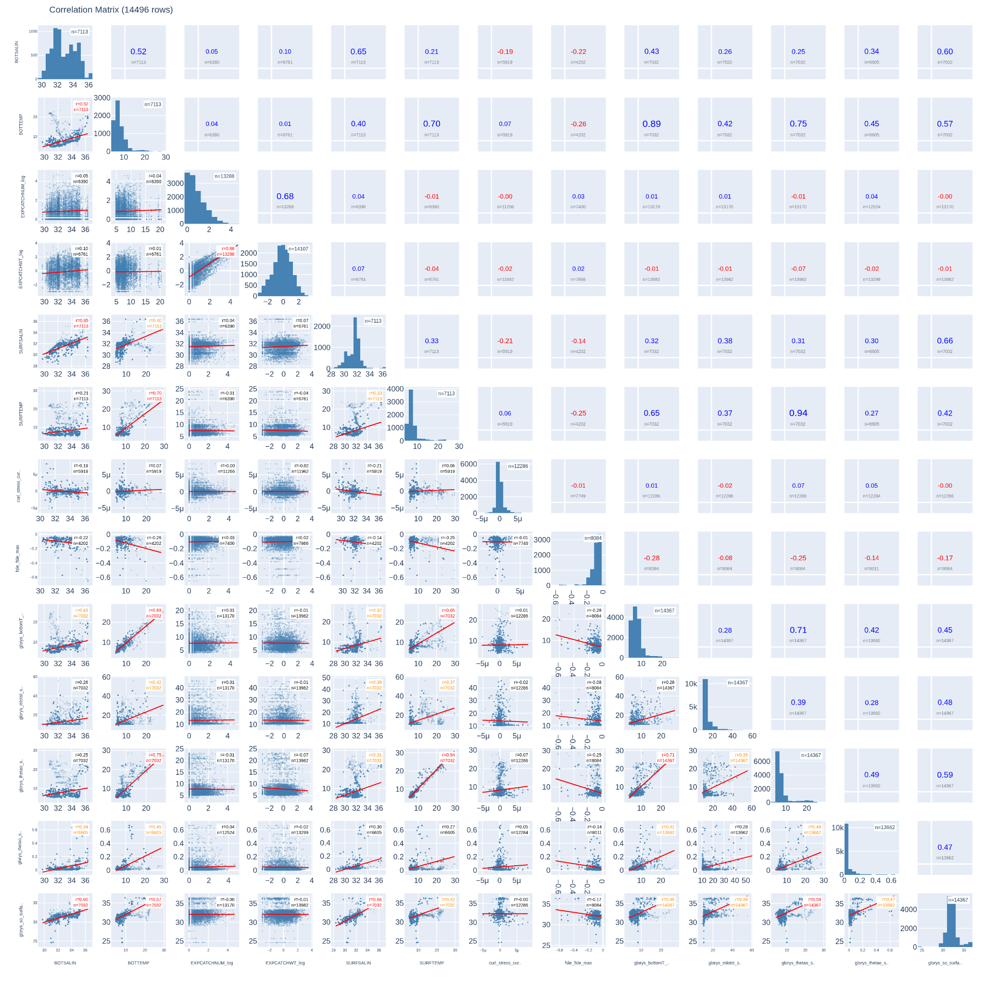
Match Ups
What we did
Matched PACE data following hackweek tutorial
Notes:
MK

Slide 8
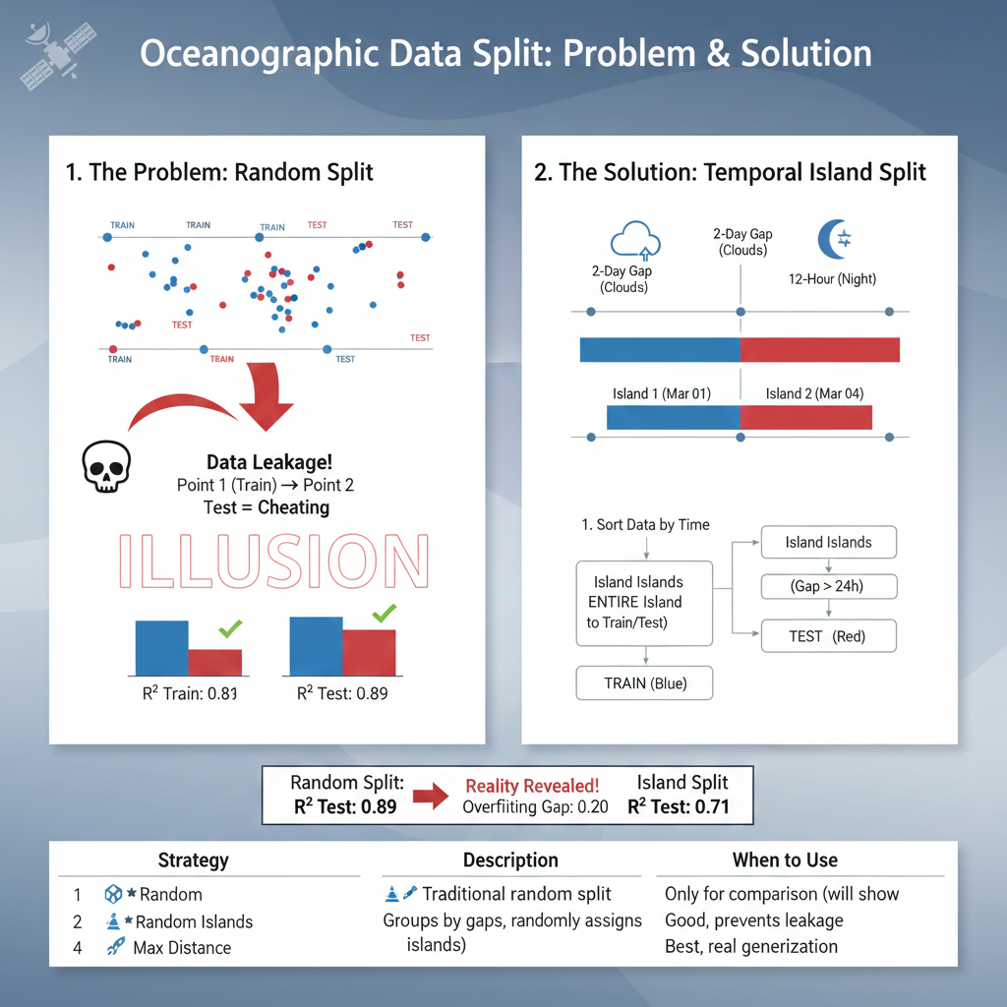
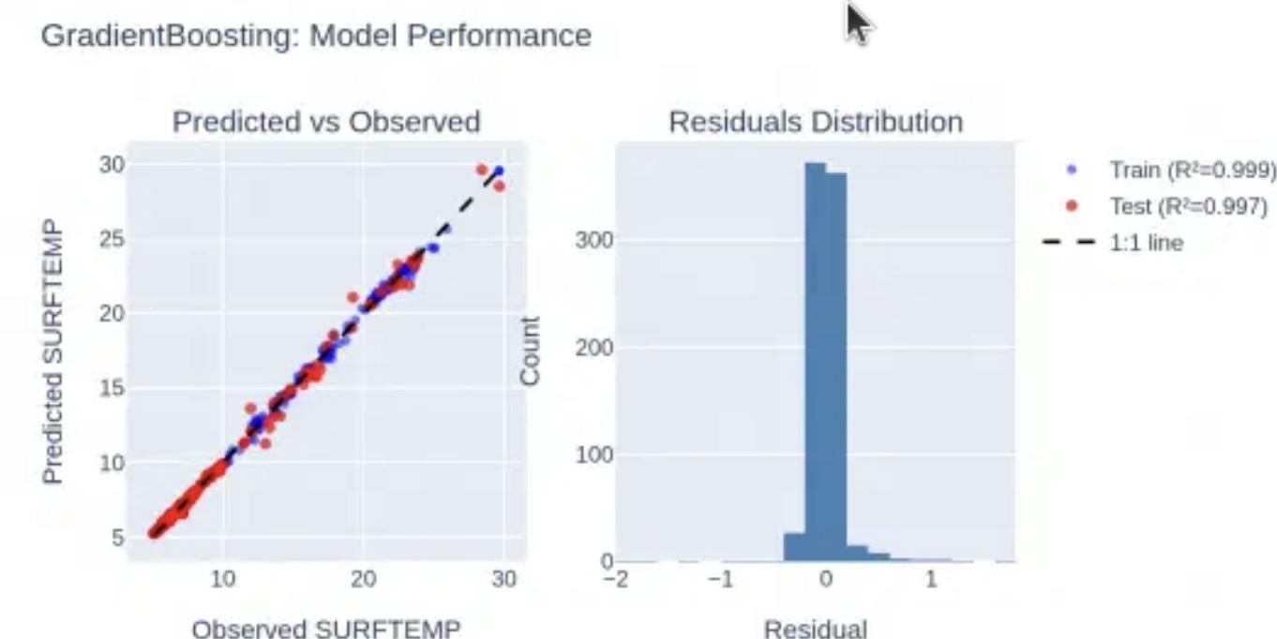
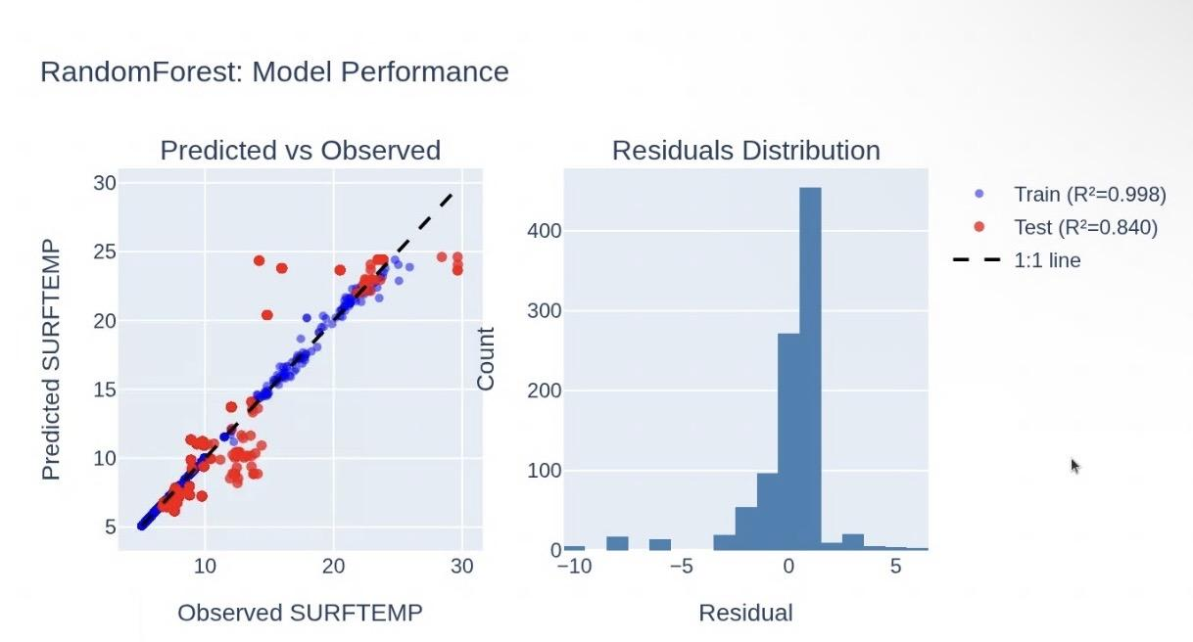
The overfit problem : still environment aspect
Notes:
VA

Slide 9
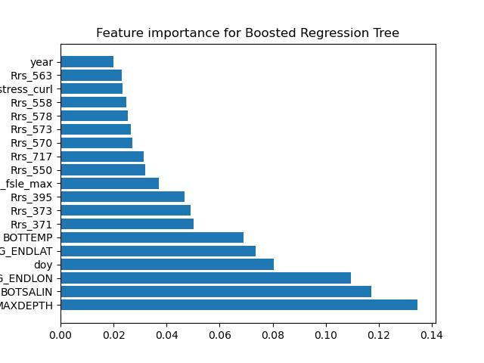

Comparison of Models - Feature importance
Notes:
punya

Slide 10
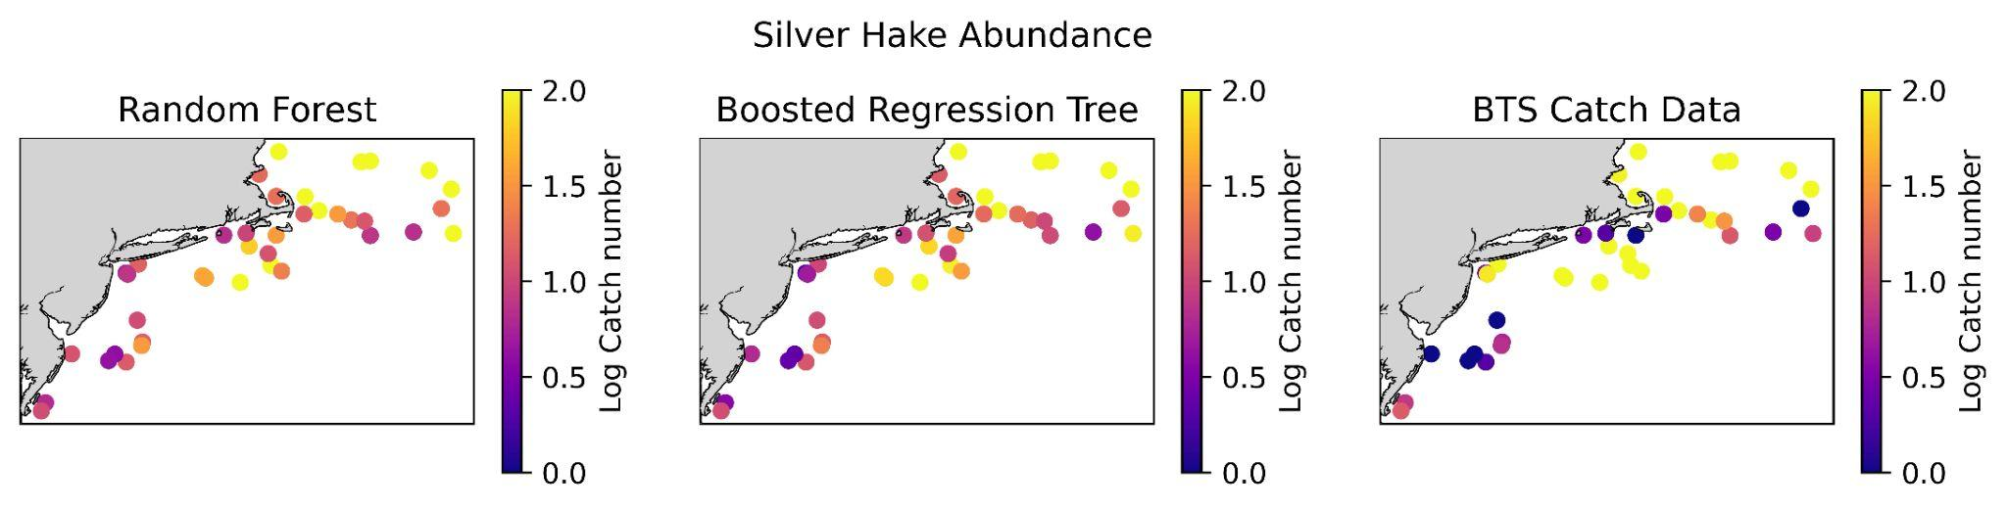
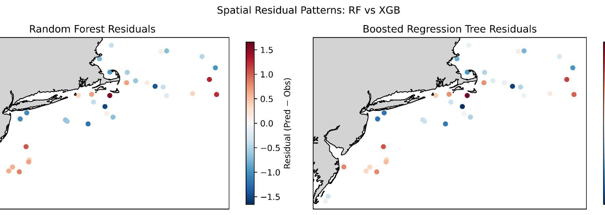
Comparison of Models - Abundance predictions
 | RF | BRT
RMSE | 0.808 | 0.764
R2 | 0.455 | 0.512
Wilcoxon p-value | 0.00195
Mean diff (RF - BRT) | 0.0435
Notes:
punya

Slide 11
Next steps & limitations
Lack of data (growing dataset. Fall 2025 is completed but not yet available)
Explore additional variables: MOANA, incorporate commercial fishing data, incorporate additional surveys
Testing other species
Testing other models (neural networks)
Notes:
HS

Slide 12
Where to find us!
Project github: https://github.com/fish-pace/2026-proj-Trawling4PACE/tree/main
Individual githubs:
Victoria - opisthoproctus
Punya - punyaravichandran
Frederic - FREDERICBONOU
Leandro - leandrometeoro
Justine - jwhitaker-cgl
Mary Kate- MMunley2
Haley Synan - hsynan
Notes:
HS

Slide 13

Thank you Ryan, Eli, and all the mentors, helpers, and organizers for such a wonderful Hackweek! We all learned so much and are so appreciative of all your time and effort in organizing this!
Notes:
HS

